Slide 1
Research on Taiwanese (Min-nan) Speech Processing
呂仁園，長庚大學電機系
rylyu@mail.cgu.edu.tw
江永進，清華大學統計所
chiang@stat.nthu.edu.tw

Slide 2
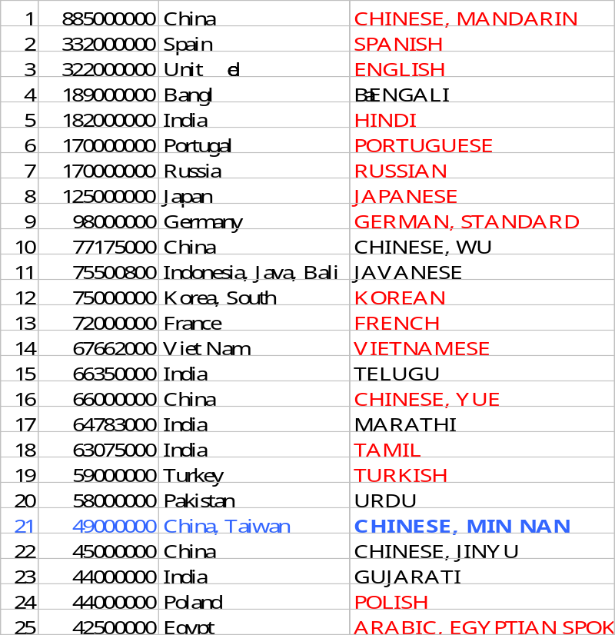
Motivations
Mandarin, Taiwanese (Min-nan), Hakka are 3 major languages spoken in Taiwan
Taiwanese is our mother tongue
It is one of the top 25 languages in the world.

Slide 3
Motivations
Chinese is not a single language but a family of mutually unintelligible languages. Min-nan is one member of the Chinese languages.
To study member languages of Chinese is very helpful in understanding Mandarin Chinese in many issues.

Slide 4
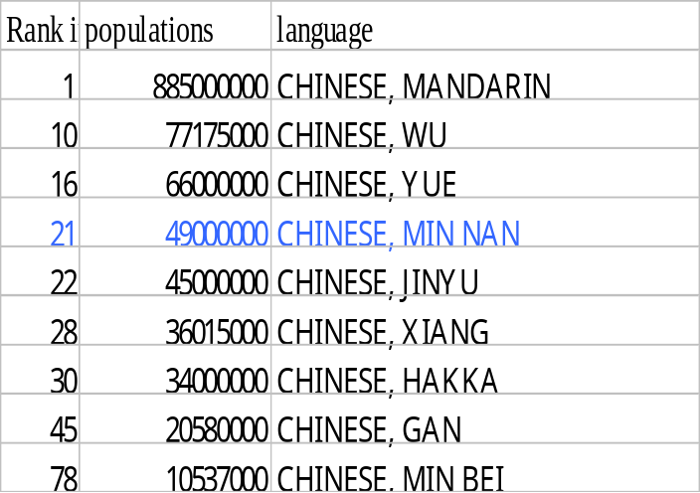
The Chinese Language(s)
    Mandarin（官話、普通話、國語）,
    Wu（吳語、江蘇話、上海話）,
    Yue（粵語、Cantonese, 廣東話、香港話）,
    Min-nan（閩南語） ,
    Jinyu（晉語、西北官話、山西話）,
    Xiang（湘語、湖南話）,
    Hakka（客家語）,
    Gan（贛語、江西話）,
    Min-bei（閩北語）
  NOT mutually intelligible in spoken form
    Just as English, Dutch, French, Spanish, Italian
  WITH a common written form (?)
    Except for Mandarin, the others do not have official written forms.
http://www.sil.org/ethnologue/top100.html

Slide 5
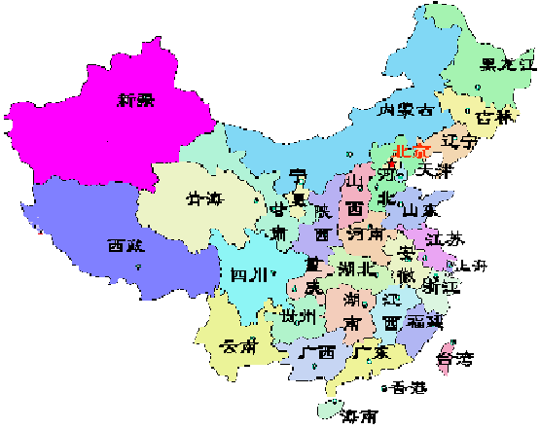
The area distribution of the Chinese languages
Mandarin
Jin
Mandarin
Wu
Gan
Xiang
Hakka
Yue
Min-nan
(Taiwanese)

Slide 6
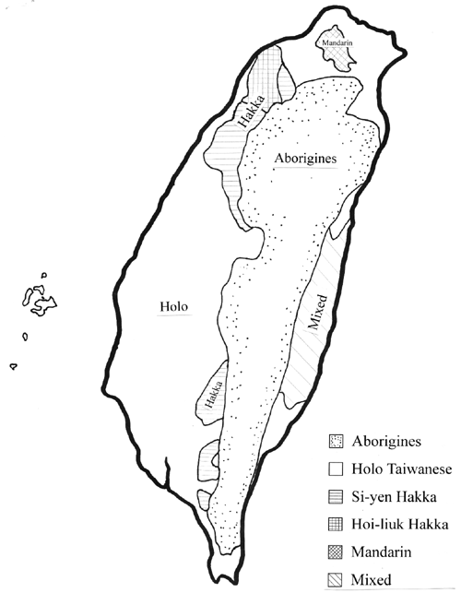
The Languages in Taiwan
Primary languages in Taiwan
  The Chinese Languages 97.8%
    Mandarin (20.1%)
      Mainlanders (20.1%)
      Almost all literate people (more than 90%)
      Taiwanese Mandarin 台灣華語
        Like British English, v.s. American English
    Min-nan (66.7%)
      Southern Min, Hokkien, Amoy, Holo
      閩南, 福佬, 河洛, 絡獠
      Taiwanese Min-nan 台灣閩南語
    Hakka (11%)
      Hakka
      Taiwanese Hakka 台灣客家語

Slide 7
The Languages in Taiwan
  Aborigines (2%)
    3 major linguistic groups
      Atayal (northern), Tsou (central), Paiwan (eastern, southern)
    about ten languages
  Foreign languages (..)
    Japanese
    English

Slide 8
Historical changes of Taiwanese Min-nan
The Historical Viewpoint of Taiwanese Min-nan
Min
Min-bei
Min-nan
Min-dong
A.C. 300
Qyuan-zhou
Zhang-zhou
A.C. 600
A.C. 1700
Qyuan-zhou
Xia-men
Tai-nan
Zhang-zhou
Nowadays
TAIWAN
Adapted from “台灣話概論”, pp.54, by 許極燉

Slide 9
Some facts about Modern Taiwanese
Taiwanese (Min-nan)
  Qyuan-zhou dominate
    Taipei, Hsin-chu, Miao-li, Chang-hua, Kaoshiung, Pin-dong, Tai-dong, Lu-gang
  Zhang-zhou dominate
    Tao-yuan, I-lan, Nan-tou, Chia-yi, I-lan
  Mixed, Xia-men (Amoy) , Tai-nan,
    Tai-chung, Yun-lin, Tai-nan, Hua-lian
Modern Taiwanese (Min-nan) becomes a mixed version of the above sub-dialects plus some Japanese and Aborigine usages

Slide 10
Multiple Pronunciations of Taiwanese
The Multiple Pronunciations of Taiwanese Min-nan
  Literate (Classical) Pronunciation (文言音)
    Used in reading classical literature
      “落花流水” pronunced as /lok hua liu sui/
    There exists some correspondence to Mandarin
  Oral Pronunciation (白話音)
    Used in daily lives
      “落花流水” pronunced as /lak hue lau zui/
    Some different sub-dialects exists
      E.g. Taipei, Tai-nan, I-lan, Lu-gang

Slide 11
Sub-dialects of Oral Pronunciation
Dominate
Tainan
Taipei
(I-lan)
Examples
i
i
u
ir
豬去魚箸佇居鼠舉旅余煮藷
u
u
u
ir
自事師思私賜四史駛資仕死書
uenn
uenn
e
er
妹糜
ue
ue
e
er
皮尾灰吹飛回歲貨火過未果綴倍炊揣稅
e
e
e
er
短袋胎坐晬災退螺
e
e
ue
ere
初矮挨街雞底洗細梳鞋地替儕溪契界題體犁齊改貯
e
e
ue
ue
買賣袂批
enn
enn
inn
inn
嬰楹井青盲更爭生暝羹鄭病棚坑彭澎
iunn
ionn
iunn
iunn
張羊唱娘場薑癢溶丈
uainn
uainn
uinn
uinn
關橫
iam
iam
iam
am
針
in
in
un
irn
均近銀根筋巾斤芹勤恨恩
ng
ng
ng
uinn
飯問門轉頓褪酸軟卵光遠算黃園磚勸損

Slide 12
Dominate
Tainan
Taipei
(I-lan)
examples
ueh
ueh
eh
erh
月襪郭
eh
eh
eh
erh
雪
ueh
ueh
uih
uih
血
eh
eh
ueh
ueh
八
eh
eh
ueh
ereh
節
iap
iap
iap
ap
汁
iang
iang
iang
ang
雙
ian
ian
ian
an
鉎
iau
iau
iau
au
ciau⁵勻，chiau⁵
iann
iann
iann
ann
囝
iak
iak
iak
ak
摔

Slide 13
Written forms of Taiwanese
Three main writing schemes of the contemporary Taiwanese
  Han (Chinese) characters only
    全漢字
  Roman script only
    全羅馬字
  Han-Roman mixed
    漢羅並用

Slide 14
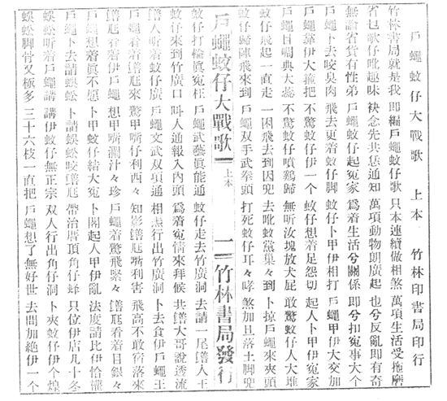
Han (Chinese) characters only 全漢字
Han (Chinese) characters only
戶蠅蚊仔大戰歌
…
戶蠅靠伊大箍把
不驚蚊仔伊一個
蚊仔想著足怨切
起人卜甲伊冤家
…..
The fly went to war against the mosquito
…..
The fly relied on his giant size.
He didn’t fear the lonely mosquito.
The mosquito was very sad while she thought about that.
She ganged her partners to fight against the fly.
….

Slide 15
Han (Chinese) characters only 全漢字
The difficulties of “Han (Chinese) characters only”
  Some Taiwanese lexicon items can't be well expressed in Han characters.
  Approximately 5% of the Taiwanese morphemes have no appropriate Han characters
  They account for as much as 15% of the total number of characters in a written Taiwanese text.
  Those 15% purely Taiwanese words are most likely to be written in different existing Han characters or even newly created Han characters by different writers.
      For detailed discussions on Han characters, see Cheng 1989, DeFrancis 1990, Norman 1991, and Chiung 1998.

Slide 16
Han (Chinese) characters only 全漢字
There are three main methods while choosing existing Han characters to represent Taiwanese words
    E.g.
      蚊仔想著足怨切 (The mosquito was very sad while he thought about that.)
  Using the same etymon （本字）
      For example “想”, has the same meaning in Taiwanese, Mandarin, Vietnamese, Korean, and Japanese with their own distinctive pronunciations.
      Different scholars may also still have different opinions on defining the etymon, like “人” v.s. “儂”.
  Sound borrowing （假借）
      the meaning of a character is ignored; only the sound is borrowed.
      For example, "足 (ziok)" is supposed to be the meaning of "foot" in classical Han writing, however, it means "very (ziok)“ here.
  Meaning borrowing （訓讀）
      The pronunciation of a character is ignored, and its meaning is borrowed to express the same meaning.
      For example, the meaning of "蚊" was borrowed to express "mosquito (vang)."
      Some users may prefer the character “蠓” (vang) to express "mosquito“.

Slide 17
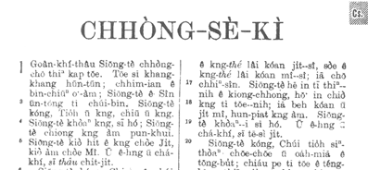
Roman script only (全羅馬字)
Roman script only
CONG-SE-GI
Quan-ki-tau Siong-de cong-zor tinn gap due. Due si kang-kang hun-dun; ……
創世紀
源起頭上帝創造天和地。
地是空空渾沌，….

Slide 18
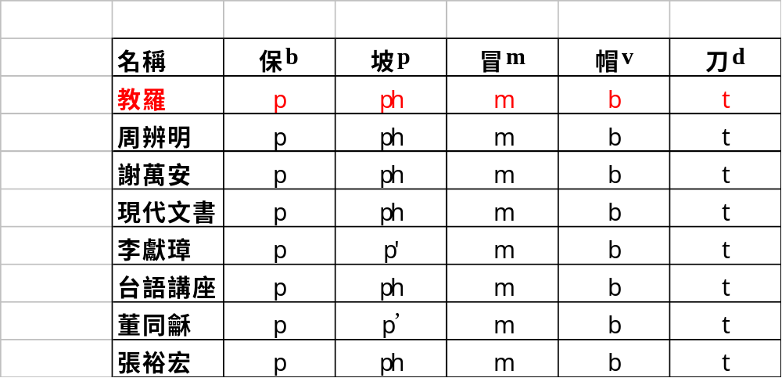
Roman script only (全羅馬字)
Many Roman-style phonetic alphabets exist nowadays.
  One of the most early used systems is the “Peh-oe-ji” （白話字）, or called “Kau-hue-lo-ma-ji” （教會羅馬字）, the traditional orthography developed by missionaries and used primarily in church to read the Bible more than a hundred years ago.

Slide 19
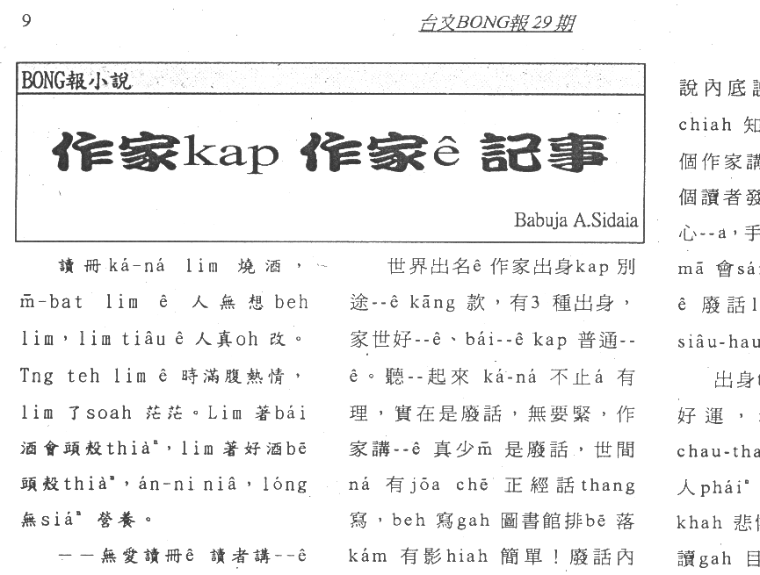
Han-Roman mixed （漢羅並用）
Han-Roman mixed
寒流過境 沈冬青
今仔下暗爸爸敢會轉來？氣象報告講zit波冷氣團會di今暗、明仔zai透早降到尚低溫。窗仔外口ｅ樹仔沙沙叫，hit年dui美國cit-tor帶轉來ｅ湯匙仔風鈴kin--kin--kin--響未停。不時窗仔門dor kit-kok-kit-kok leh 搖動，啊，敢會又gorh leh地動啊？倒di眠床頂，我m敢gorh想落去。
Hit一暝大地動ｅ時，窗仔門dor是an-ne開始振動ｅ。媽媽抱著小傑di暗sor-sorｅ房間內na摸na喝(huat)，ga我gah阿威dui頂、下舖叫精神。Hit當陣ｅ眠床假若(gana)是浮di海頂，海湧liam-mi高liam-mi低，我陷(ham)眠陷dak，iau m知發生啥麼代誌。到zimma，我猶原想ve起hit一暝是an-na 對頂舖爬落來ｅ？an-na qiu著阿威due di媽媽ｅ後尾，母仔囝四個人giu做一伙，vih di樓腳客廳ｅ一角仔。爸爸若di厝lin著好啊！我m vat看過媽媽ziah-ni驚慌。

Slide 20
Han-Roman mixed （漢羅並用）
A compromise between Han-only and Roman-only
  Arose in the late 1980s.
  The drawbacks of Han-only
    The existence of various characters for identical words has reduced reading efficiency, and made the readers likely to confuse the meaning of sentences.
  The drawback of Roman-only
    Most Taiwanese are skilled in using Han characters instead of Romanization, texts in Roman-only scripts may reduce their fluency in reading.
  The drawback of Han-Roman
    Different writers may have different degrees of comprehension of Han characters, the percentage of Roman script used in a text varies from person to person.
Generally speaking, the Han-Roman (漢羅) orthography is the most common style for writing Taiwanese in the contemporary Taiwan (1990s). Most Taiwanese publications are published in Han-Roman.

Slide 21
Taiwanese Phonetics
Like Mandarin Taiwanese is also a tonal, syllabic language.
  The phonetic transcription adopted here is the Tong-yong phonetic Alphabet (TYPA), which can be used for all (Chinese) languages used in Taiwan, including Mandarin, Taiwanese, and Hakka.
  17 Consonants for Taiwanese
    b, p, m, v, d, t, n, l, g, k, ng, q, h, z, c, s, r
  6 Vowels for Taiwanese
    a, o, er, e, i, u
  5 “Vowel-Modifiers” for Taiwanese
    -nn, -p, -t, -k, -h
7 Tones for Taiwanese
  當, High-Level
  洞, Mid-Level
  棟, Low-Falling
  黨, High-Falling
  同, Low (Mid) -Rising
  獨, High-Stop
  毒, Mid (Low) -Stop

Slide 22
Tong-yong phonetic Alphabet (TYPA)
MPA
Pinyin
IPA
WB
SP-T
TYPA
TYPA compared with the other phonetic alphabets
  M: Mandarin
  T: Taiwanese
  H: Hakka
M
M
MTH
M
MTH
M
T
H
Ex
C
1
ㄅ
b
p
p
b
b
b
b
八ba
2
ㄆ
p
p’
ph
p
p
p
p
趴pa
3
ㄇ
m
m
m
m
m^
m
m
m
媽ma
梅m
4
ㄈ
f
f
f
f
f
f
發fa
5
ㄉ
d
t
t[
d
d
d
d
搭da
6
ㄊ
t
t’
t[h
t
t
t
t
他ta
7
ㄋ
n
n
n
n
n
n
n
那na
8
ㄌ
l
l
l
l
l
l
l
拉la
9
ㄍ
g
k
k
g
g
g
g
嘎ga
10
ㄎ
k
k’
kh
k
k
k
k
喀ka
11
ㄏ
h
x
x
h
h
h
h
哈ha

Slide 23
Tong-yong phonetic Alphabet (TYPA)
MPA
Pinyin
IPA
WB
SP-T
TYPA
TYPA
for consonant
M
M
MTH
M
MTH
M
T
H
Ex
C
12
ㄓ
zh
t▪
thsr
dz`
zh
zh
渣zha
13
ㄔ
ch
t▪’
tsr
ts`
ch
ch
差cha
14
ㄕ
sh
▪
sr
s`
sh
sh
殺sha
15
ㄖ
r

r+
z`
rh
rh
然rhan
16
ㄗ
ㄐ
z
j
ts
t☑
ts
cC
dz
dz\
z
z
z
匝za
機zi
17
ㄘ
ㄑ
c
q
ts’
t☑’
tsh
cCh
ts
ts\
c
c
c
擦ca
七ci
18
ㄙ
ㄒ
s
x
s
☑
s
C
s
s\
s
s
s
撒sa,
西si
19
z
✓
DZ
r
如ru
字ri
20
b
B
v
v
肉 va
21
g
G
q
我 qua
22
ㄤ
-ng

N
N
J
n^
ng
ng
骯ang
雅nga
黃ng

Slide 24
Tong-yong phonetic Alphabet (TYPA)
TYPA
for vowel
MPA
Pinyin
IPA
WB
SP-T
TYPA
M
M
MTH
M
MTH
M
T
H
Ex
V
23
ㄚ
a
a
@
A
a
a
a
a
阿a
24
ㄛ
o

>
o
o
o
o
喔o
25
o
or
蚵 or
26
ㄜ
e

2
@
er
er
er
鵝er
27
ㄝ
ê

E
e
e
e
e
也ie
28
ㄦ
er

&r
@`
err
而err
29
ㄧ
y,
i

j
I
i:
i
i
i
i
一i
金zin
機zi
30
ㄨ
w
u
u
w
&
u
u
u
u
u
吳u
蹲dun
度du
31
ㄩ
yu
ü
y
jw
y
y
yu
原yuan
淤yu
Nu
32
i
ï
If
4r
U,
U`
ii
ii
之zhii
資zii
Na
33
~
-nn
餡ann
St
34
-p
p}
-p
-p
壓ap
35
-t
t}
-t
-t
握at
36
-k
k}
-k
沃ak
37
-h
?
-h
-k
鴨ah

Slide 25
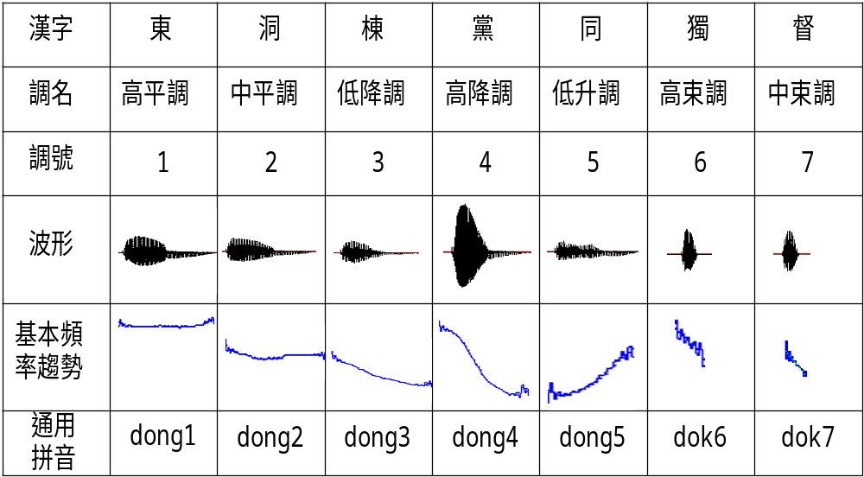
Tones
The 7 Taiwanese Tones

Slide 26
Tones
The Tone Sandhi Rules
  The tone of a character should be changed, when it is NOT in the position of the END of a multi-syllabic word.
  E.g.
    正當(dong1) v.s. 當(dong2)時
    山洞 (dong2) v.s. 洞(dong3)口
  The rules can be described as follows
5
-p,-t,-k
-h
南
北
6
7
6
7
1
2
3
4
8
6
3
6

Slide 27

Taiwanese TTS
Based on waveform concatenation
Using tonal syllables as units
Text analysis is the current concern
  Text to phonetic-symbol
  tone sandhi

Slide 28
Mandarin/Taiwanese Bilingual Speech Recognition
The comparisons of phones of Mandarin (M) and Taiwanese (T)
Syllables
Phones
RCD Phones
M
407
36
186
T
825
49
444
M∪T
1049
60
529
M∩T
183
25
101

Slide 29
Taiwanese Lexicon
There are many Taiwanese dictionaries commercially available nowadays.
  台日大辭典, by 小川尚義, 台灣總督府
  廈門音新字典, by Cambell, 1913
  普通話閩南方言辭典, by 廈門大學，1982
  國台雙語辭典, by 楊青矗, 1992
  國台對照活用辭典, by 吳守禮, 2000
But almost none of them are electronically readable.
The one used here is edit by Prof. Chiang Yuang-chin in Tsing-hua Univ.
  About 60K Taiwanese words with pronunciations in TYPA
  Used first in Chiang’s Dai-im Input Method

Slide 30
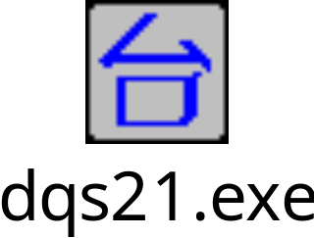
Taiwanese Speech Corpora
A set of tonal syllables and a set of phonetically balanced words extracted from the 60K-word lexicon
Speech Data Collection Environment
Speech of about 100 speakers are collected till the current time
  Each speaker has about 7 min of Taiwanese and 7 min of Mandarin
  Totally more than 20 hours of T/M speech

Slide 31
Acoustic Modeling
529 M/T RCD-phones
  186 Mandarin RCD-phones
  444Taiwanese RCD-phones
  Only intra-syllabic context is considered
16 ms analysis window, 8 ms window shift
26-dim feature vectors
  MFCC, delta-MFCC, energy, delta-energy
3 states, 3 mixtures for each CHMM

Slide 32
Task Definition
Medium-Vocabulary Special Domain Continuous Speech Recognition
Large-Vocabulary Multi-syllabic Word Recognition
<fig.1 > The searching net of bilingual word tree
<fig.2> the finite-state grammar for a specific domain
sil
dai
bak
sil
台北
日期
ci
sil
台北市
uan
sil
台灣
時段
der
sil
台灣島
我要
掛
結束
sil
科目
tai
bei
台北
shiii
sil
台北市
醫生
uan
sil
台灣
開始
dau
sil
台灣島
我的
病歷號碼
數字

Slide 33
Experimental Results
Some preliminary experimental results for 20K Taiwanese words and 20K Mandarin words in the speaker-dependent case
The statistics of the bilingual speech corpus
The word accuracy (%) of the bilingual Mandarin/Taiwanese speech recognition
Lang
Script
Speech Length (min)
Train
T
Syll
91.35
Testing speech
Word
134.65
T
M
M/T
M
Syll
26.95
Trained
models
T
95.98
Word
94.43
M/T
Total
411.73
M
85.06
94.67
89.26
Test
T
Word
1000 words
M/T
92.55
M
Word
1000 words

Slide 34
More experiments
Experiments on speaker independent cases are under going....

Slide 35
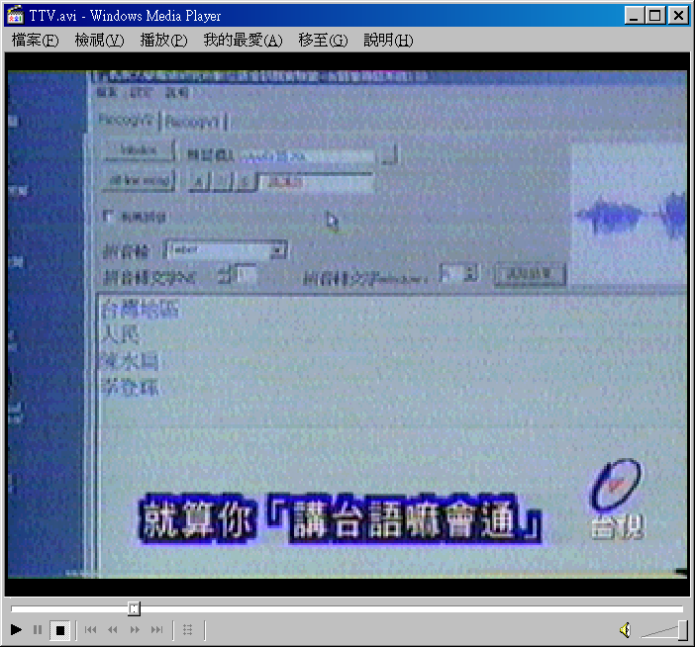
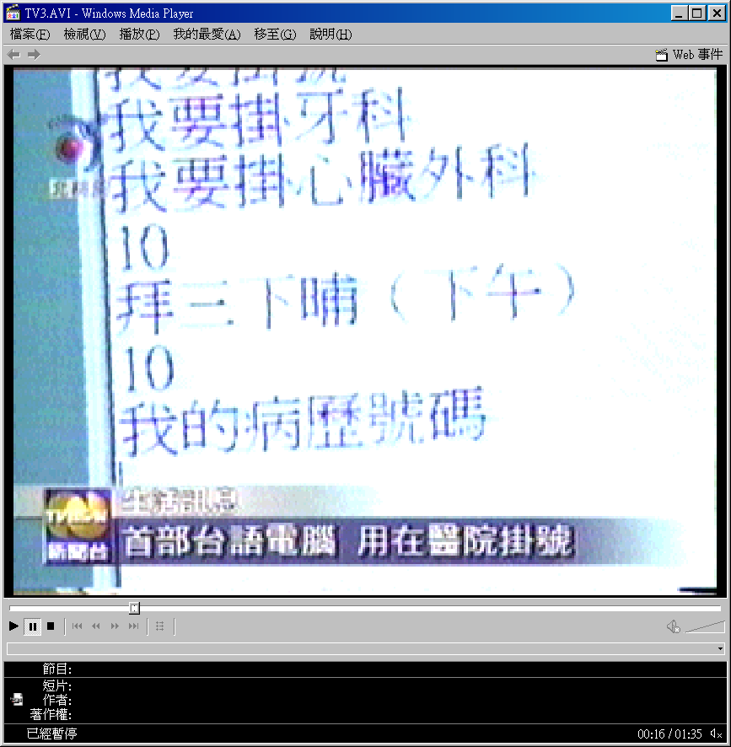
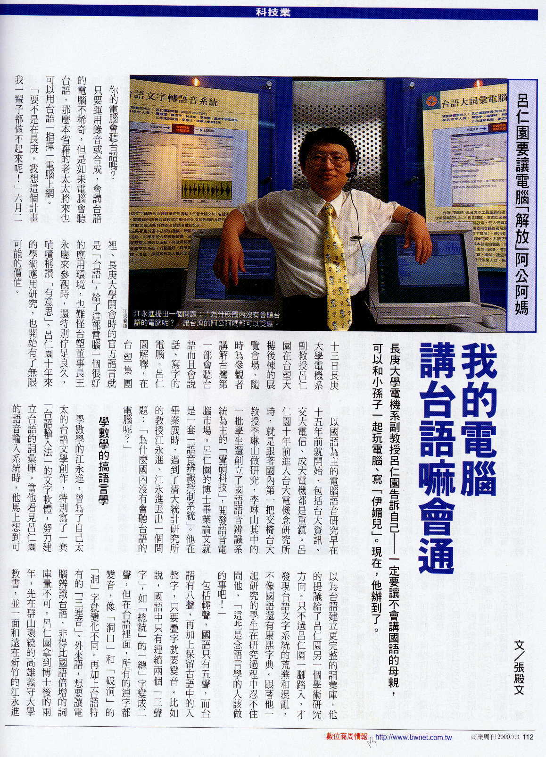
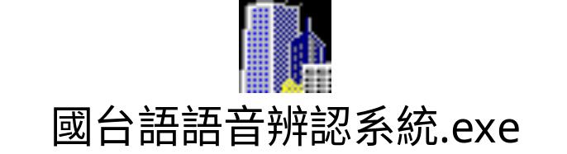
Press Reports
TVBS, Business Weekly （商業週刊） and TTV（台視） reported our research.
magazines.sina.com/businessweekly/contents/658/658-006_1.html

Slide 36
Future Work
Multilingual Issues
Telephone Speech Recognition
Dialog System

